Slide 1

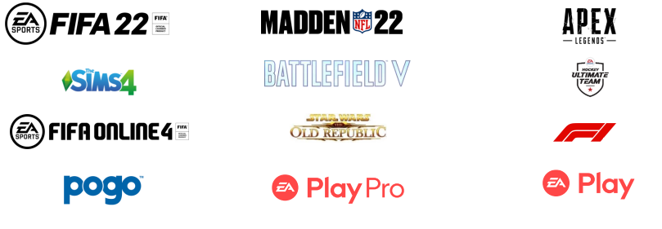
electronic arts| M&A profile
Headquarters: | Redwood City, CA
Founded: | 1982
# Employees: | 12,900
CEO: | Andrew Wilson
Electronic Arts Inc. (“EA” or the “Company”) is an American video game company that develops and publishes games, content and services across the traditional console, PC, and mobile device markets. The Company’s IP portfolio includes a mix of wholly owned franchises (list franchise names) as well as licensed content (Madden NFL, Star Wars). In FY 2021, the EA player network had more than 580 million unique active accounts and offices is 18 countries.
In 2021, the global video game market size was estimated at ~$200B and is expected to grow at a compound annual growth rate (CAGR) of 13.0% from 2022 to 2030
The industry has recently undergone a period of increased consolidation highlighted by Microsoft’s announced $69B acquisition of Activision Blizzard and Take-Two’s completion of its combination with Zynga
Investment Rationale:
Strengthen Gaming Capabilities – Disney officially ended its stint as a publisher of video games in 2016, transitioning exclusively to a licensing model. By acquiring EA, Disney would not only absorb the Company’s existing intellectual property and library of over 300+ gaming titles, but its entire development and distribution interface, immediately increasing its gaming footprint and driving future creation of in-house content to bolster its portfolio of existing IP
Realize Synergies with ESPN– By acquiring EA, one of the most prolific and iconic developers of such famous sport game franchises like Madden, NHL, UFC, and FIFA, Disney could position itself to creating its own sports metaverse by leveraging its on-air talent as well as its related programming and channels to deliver highly compelling and unique user experiences that further increase the stickiness with its global sports audience and offer ESPN+ subscribers new and exciting products and services
Revenue: $7.8B
EBITDA: $1.8B
Market Cap: $36.0B
Proforma Financial Summary ($ in Billions)
Proforma Capital Allocation / Leverage
Representative Franchise Assets
Before
After
Debt / Equity Ratio: 0.24
Debt / Equity Ratio: 0.21
4.3x Debt / EBITDA
3.8x Debt / EBITDA
Notes:
The strategic acquisition of Octane Fitness, which emphasizes core competencies in specialty retail and international distribution channels, is complementary to Nautilus’ strengths in the direct-to-consumer and mass merchant retail sales, however, an acquisition of Pivotal 5 would further enhance

